Slide 1
My Garden Memories

Slide 2
Gardening With My Grandmother
Vegetable Garden
Fruit and Berry Areas

Slide 3
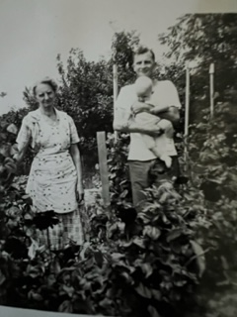
Enjoying the Berry Patch – With a Little Help From My Dad

Slide 4
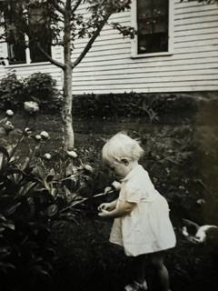
Helping With the Flowers

Slide 5
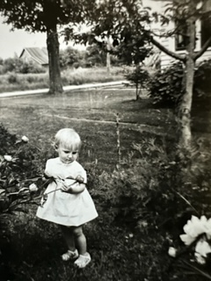
Inspecting the Flowers

Slide 6
Benefits of Gardening with Kids
Gardening teaches children responsibility since they have to water, feed, and weed their plants.

Slide 7
Benefits of Gardening with Kids
Gardening teaches children where their food comes from.
Children receive botany lessons when they learn about plant parts and life cycles.

Slide 8
Benefits of Gardening with Kids
Gardening teaches sustainability when children learn about composting and rainwater harvesting.

Slide 9
Benefits of Gardening with Kids
Gardening teaches patience. Children watch as plants change from day to day and week to week. Select quick-growing plants for their first garden.

Slide 10
Tips for Gardening with Kids
Start with a small project. Give them their own garden area, and plant one or two plant varieties.

Slide 11
Tips for Gardening with Kids
Let them have a voice in planning their garden. Plant something they like to eat, or plant flowers in their favorite colors. Look for plants that entice their senses.

Slide 12
Tips for Gardening with Kids
Get them their own tools – hoe, spade, trowel, and garden gloves. Let them have their own garden plot, garden plants, and garden tools.

Slide 13
Fun Garden Activities
Grow plants in the child’s favorite colors.
Choose some edible plants – veggies, herbs, or flowers.

Slide 14
Fun Garden Activities
Plan ahead. Select some pollinator plants so they can watch for caterpillars, butterflies, and bees.

Slide 15
Tips for Garden Activities
Learn the ways the plants are used.
Make a pizza garden by planting tomatoes, basil, onions and bell peppers.

Slide 16
Tips for Garden Activities
Let them decorate their space with garden art such as birdhouses or painted rocks.

Slide 17
Final Thought
Set an example for the child by providing regular and proper care to your own garden.

